Slide 1


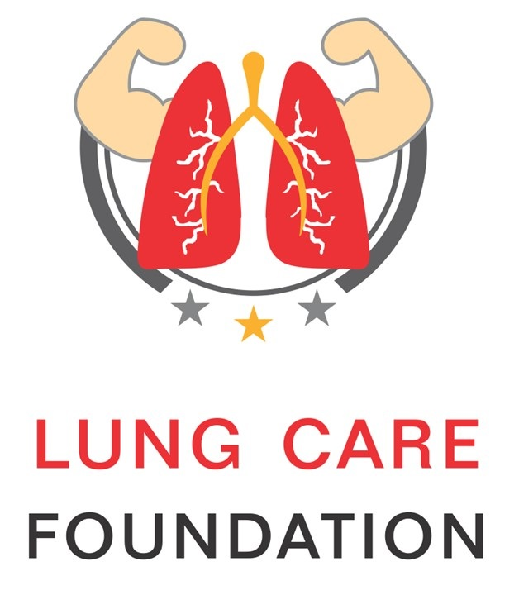
Understanding Air Pollution
A Brief For You
www.dfca.org.in

Slide 2
Consider
These
  We breathe 25,000 times a day
  We can live without food: 21 Days
  (we can carry food with us)
  We can live without water: 5 Days
  (we can carry food with us)
  We can live without air: Not more than 3 minutes
  (We can not carry air with us)
www.dfca.org.in

Slide 3
Consider
These
  22 out of the 50 most polluted cities globally are in India.**
IN INDIA
  Ambient / Outdoor Air Pollution deaths: 6,27,000*
  Outdoor + Indoor Air Pollution deaths: 12,00,000*
*State of Global Air/2019, Available from: https:// https://www.stateofglobalair.org/sites/default/files/soga_2019_report.pdf
**WHO, Available from: https://www.who.int/health-topics/air-pollution#tab=tab_1
www.dfca.org.in

Slide 4
Defining Air Pollution
Air pollution, by definition, refers to the presence of undesirable components (above the set limits) that contaminate the air and are detrimental to human health, ecosystem or planet as a whole.
There are 2 kinds of Air Pollution: 1. Ambient (Outdoor) 2. Household (Indoor)
Ambient
Outdoor Air Pollution
Contamination of outside air due to toxic emissions from combustion of fuels, chemical industries, vehicles, construction activities etc
Major pollutants
• Particulate Matter (PM)
• Nitrogen Oxides
• Carbon Monoxide
• Ozone
• Sulphur Dioxide
Of all the pollutants, fine Particulate Matter (PM) has the greatest detrimental effect on human health.
www.dfca.org.in

Slide 5
Household
Indoor Air Pollution
Contamination of the air inside homes and buildings by fossil fuel/biomass burning and compounds such as formaldehyde, asbestos, pesticides, lead, cleaning solvents, chloroform and household dust. Indoor air pollution is 5-10 times more harmful than outdoor air pollution.
Major pollutants
• Particulate Matter
• Carbon Monoxide
• Formaldehyde
• Other toxins
Women and children from low-income groups are particularly vulnerable because they cook in a multipurpose room, spending long hours in kitchen, with greater exposure to smoke, heat and other pollutants.
www.dfca.org.in

Slide 6
Type of Pollutants in Air
Gaseous
Pollutants
Mixture of gases and hydrocarbons suspended in the air above permissible limits. These toxic gases are released from combustion of fossil fuels and atmospheric reactions etc.
Nitrogen Oxide
Sulphur Dioxide
Carbon Monoxide
Volatile Organic Compounds (VOCs)
Greenhouse Gases such as Methane
Ground Level Ozone
Black Carbon (Sooty Particles)
www.dfca.org.in

Slide 7

Type of Pollutants in Air
Particulate Matter (PM)
Particles containing a mix of toxic metals, hydrocarbons & liquids suspended in the air that can penetrate deep into the airways, lungs and then enter the bloodstream to cause damage.
They are divided as per their size.
PM10 (10 micron) and PM2.5 (2.5 micron) and Ultrafine (less than 1 micron) are the important particles.
Particles with diameter of 10 microns or less.
Primarily come from Dust.
Can pass through the nose, throat and enter the lungs.
Includes airborne particles like pollen, mold etc.
PM 10
www.dfca.org.in

Slide 8
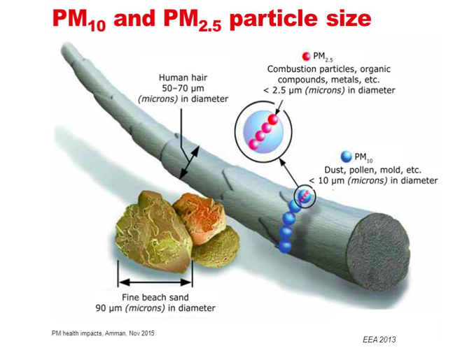
Type of Pollutants in Air
Particulate Matter (PM)
PM 2.5
Particles with diameter of 2.5 micron or less.
Can penetrate deep into the lungs and enter the bloodstream.
Includes emissions from combustion engines, organic compounds, metal industries etc
At 1/20th the width of a human hair, PM 2.5 particles are linked to many diseases, from cancer to asthma to autism.
Picture credit:
United States Environmental Protection Agency
www.dfca.org.in

Slide 9
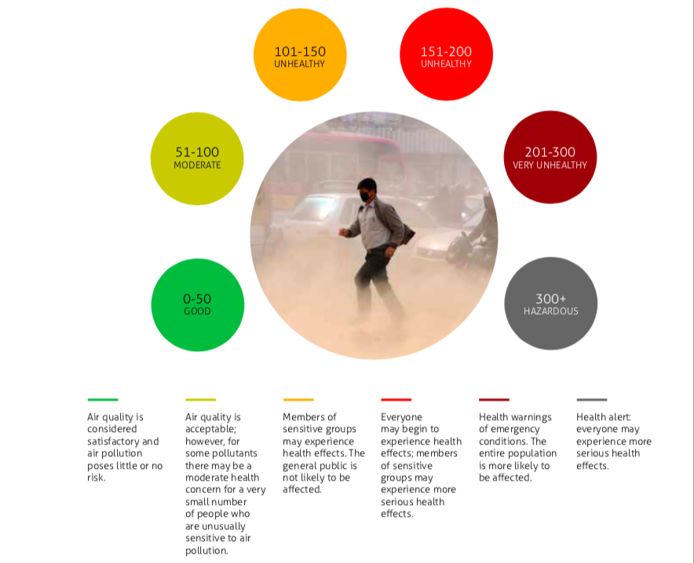
What is Air Quality Index (AQI) ?
The AQI is an index for reporting daily air quality.
It tells you how clean or polluted your air is, and what associated health effects might be a concern for you.
It converts the levels of various air pollutants (including particulate matter and gases) into a single number.
A range of these numbers is colour coded (see the picture on right side ) to convey severity of Air Pollution which corelates with health impacts.
It also conveys the urgency and level of response from the government and public to reduce exposure
Sources to access AQI data for your city
http://safar.tropmet.res.in/
http://aqicn.org/map/india/
https://app.cpcbccr.com/AQI_India/
Picture Source: Every Breath Counts report for Climate Trends, compiled by Bahar Dutt
www.dfca.org.in

Slide 10
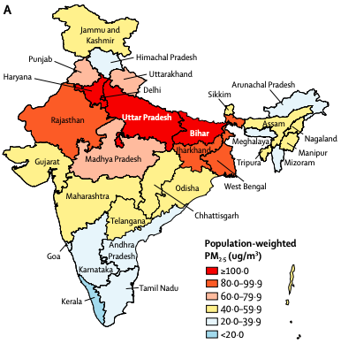
Annual Exposure to toxic PM2.5 in India
The annual population-weighted mean exposure to ambient particulate matter PM2·5 in India was 89·9 μg/m³ in 2017. (WHO standard: 10 μg/m³)
(Indian standard: 40 μg/m³)
Most states, and 76·8% of the population of India, were exposed to annual population-weighted mean PM2·5 greater than 40 μg/m³, which is the limit recommended by the National Ambient Air Quality Standards in India.
Delhi had the highest annual population-weighted mean PM2·5 in 2017, followed by Uttar Pradesh, Bihar, and Haryana in north India, all with mean values greater than 125 μg/m³.
PM₂.₅ concentration in the states of India, 2017 (A) Population-weighted mean ambient air PM₂.₅
Source : Balakrishnan K, Dey S, Gupta T, Dhaliwal RS, Brauer M, Cohen AJ, et al. The impact of air pollution on deaths, disease burden, and life expectancy across the states of India: the Global Burden of Disease Study 2017.
The Lancet Planetary Health. 2019 Available from: https://www.thelancet.com/action/showPdf?pii=S2542-5196%2818%2930261-4
www.dfca.org.in

Slide 11
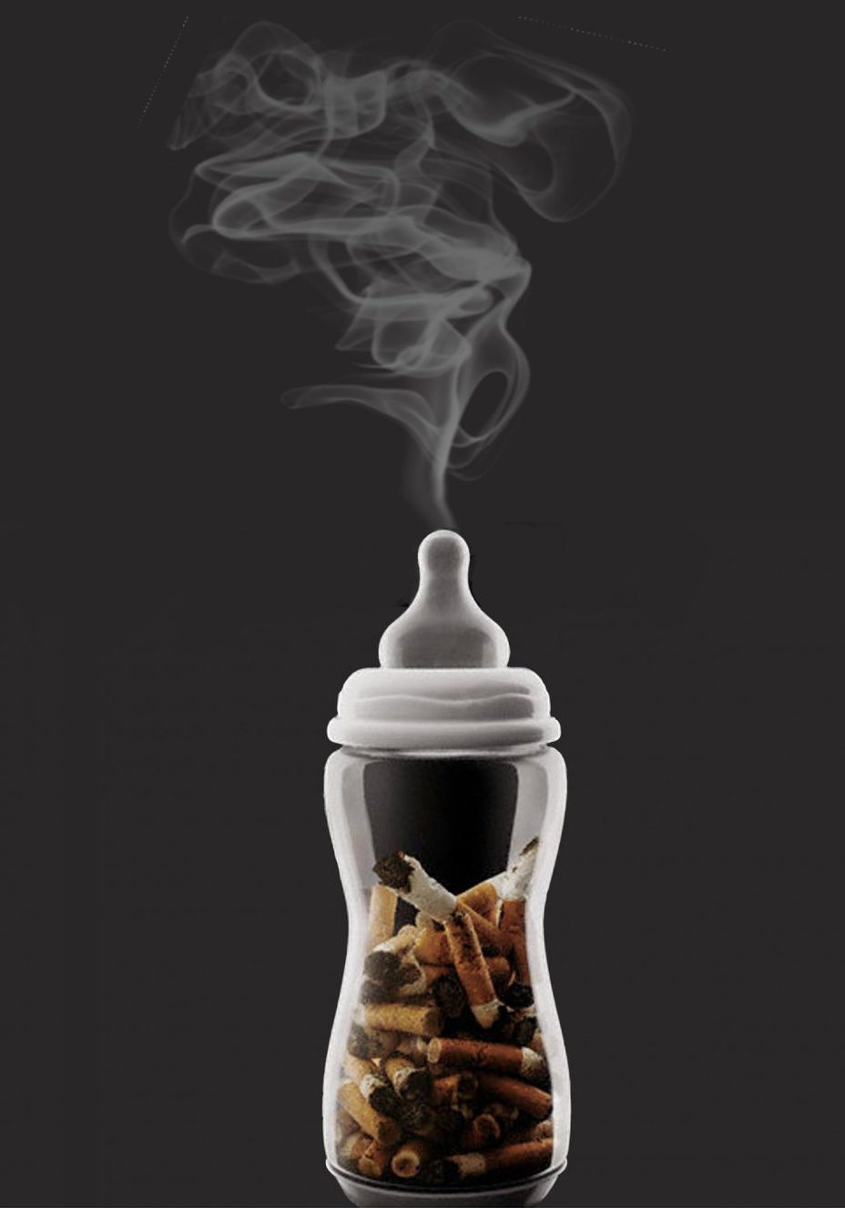
Air Pollution
The Invisible Killer
In terms of health damage, 22 μg/m³ PM 2.5 = 1 cigarette smoke**
Every Indian citizen, on an average, smokes 4-6 cigarettes a day
In times of peak pollution, it may be 25-30 cigarettes a day
Breathing Polluted Air = Smoking !
There is no non-smoker in polluted cities
This includes New-borns too! (New-born smokers)
Air Pollution is a Group 1 Cancer causing agent.*
New-born Smokers
*According to the International Agency for Research on Cancer
**According to A Berkley Earth Study on Equivalence of Air Pollution and Cigarette http://berkeleyearth.org/air-pollution-and-cigarette-equivalence
www.dfca.org.in

Slide 12
Air Pollution
The Invisible Killer
30 Years Of Chest Surgery: A Chest Surgeon’s Perspective
1988
2018
90% Lung Cancers: Smokers 10% Non Smokers
Average Age Of Lung Cancer 50-60
Almost No Women
Colour of Lungs: Pink in non-smokers; Black In Smokers
50% Lung Cancers Smokers – 50% Non Smokers
Average Age Of Lung Cancer 30-40
40% Women Patients
Colour of Lungs: Black in non-smokers as well as Smokers
www.dfca.org.in

Slide 13
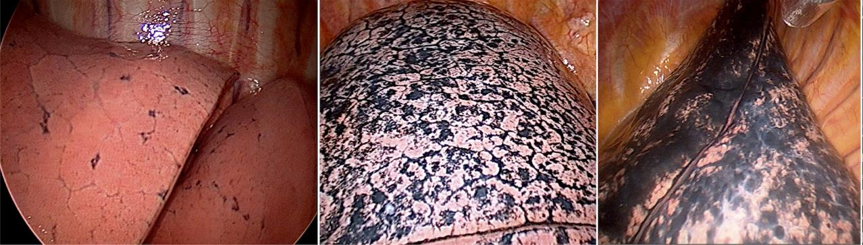
Air Pollution
The Invisible Killer
PINK LUNGS
AS WE ARE BORN WITH
COLOUR OF LUNGS OF A NON SMOKER
IN DELHI
COLOUR OF LUNGS OF
A SMOKER
www.dfca.org.in

Slide 14


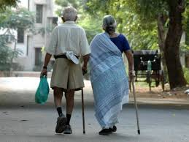
Air Pollution
The Invisible Killer
If you breathe
you are under the attack of air pollution.
Who are most vulnerable?
Unborn babies
Children
Elderly
www.dfca.org.in

Slide 15
LONG TERM EFFECTS
Air Pollution
The Invisible Killer
SHORT TERM EFFECTS
Picture Credit : https://ncdalliance.org/resources/airpollution-policybrief
Ref.: Air Pollution and Noncommunicable Diseases: https://journal.chestnet.org/article/S0012-3692(18)32722-3/fulltext
www.dfca.org.in

Slide 16
Air Pollution
The Invisible Killer
Picture Credit: https://breathelife2030.org/
www.dfca.org.in

Slide 17
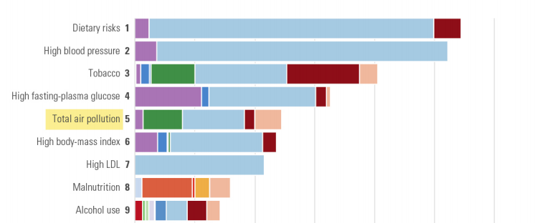
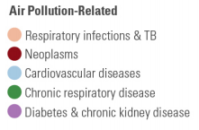

Air pollution is the 5th leading risk factor for mortality worldwide.
Photo credits & Ref.: Health Effects Institute. 2019. State of Global Air 2019. Special Report. Boston, MA: Health Effects Institute.
Available from: https://www.stateofglobalair.org/sites/default/files/soga_2019_report.pdf
www.dfca.org.in

Slide 18
According to the Global Burden of Disease Study 2017
Of the total 480·7 million DALYs in India in 2017, 38·7 million or 8·1% were attributable to air pollution. (The disability-adjusted life year is a measure of overall disease burden, expressed as the number of years lost due to ill-health, disability or early death)
Of the total DALYs attributable to air pollution in India in 2017, the largest proportions were from:
  Lower respiratory infections (29·3%)
  Chronic obstructive pulmonary disease (29·2%)
  Ischemic heart disease (23·8%), followed by stroke (7·5%)
  Diabetes (6·9%)
  Lung cancer (1·8%)
  Cataract (1·5%)
Source : Balakrishnan K, Dey S, Gupta T, Dhaliwal RS, Brauer M, Cohen AJ, et al. The impact of air pollution on deaths, disease burden, and life expectancy across the states of India: the Global Burden of Disease Study 2017.The Lancet Planetary Health. 2019
Available from: https://www.thelancet.com/action/showPdf?pii=S2542-5196%2818%2930261-4
www.dfca.org.in

Slide 19
Health Impacts Of Air Pollution On
Respiratory System
Airway obstruction
Cough
Wheezing
Shortness of breath
Asthma
Emphysema
Chronic Obstructive Pulmonary disease (COPD)
Lung Cancer
Pneumonia & Reduced Lung Capacity in Children
Higher incidence of Tuberculosis
Picture credit: pngfans.com
Ref.: Kurt OK, Zhang J, Pinkerton KE. Pulmonary Health Effects of Air Pollution. Curr Opin Pulm Med. 2016 Mar;22(2):138–43.
Available from: https://www.ncbi.nlm.nih.gov/pmc/articles/PMC4776742/pdf/nihms-759816.pdf
Sharma M, Kumar VN, Katiyar SK, Sharma R, Shukla BP, Sengupta B. Effects of particulate air pollution on the respiratory health of subjects who live in three areas in Kanpur, India. Arch Environ Health. 2004.
Available from: https://www.researchgate.net/publication/7525600_Effects_of_Particulate_Air_Pollution_on_the_Respiratory_Health_of_Subjects_Who_Live_in_Three_Areas_in_Kanpur_India
www.dfca.org.in

Slide 20
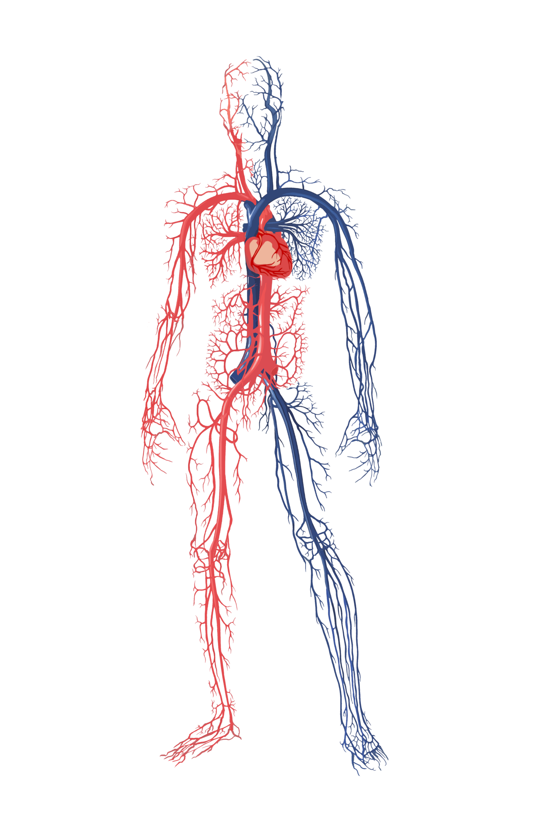
Health Impacts Of Air Pollution On
Cardiovascular System
Myocardial infarction
Coronary artery disease
Ischemia
Heart failure
Arrhythmias
Stroke
Increased cardiovascular mortality
Hypertension
Arteriosclerosis
Accelerated Progress of Atherosclerosis
Ref.: Bourdrel T, Bind M-A, Bejot Y, Morel O, Argacha J-F. Cardiovascular effects of air pollution. Archives of Cardiovascular Diseases. 2017 Nov;110(11):634–42. Available from: https://www.ncbi.nlm.nih.gov/pmc/articles/PMC5963518/pdf/nihms949393.pdf
Health Effects Institute. 2019. State of Global Air 2019. Special Report. Boston, MA: Health Effects Institute. Available from: https://www.stateofglobalair.org/sites/default/files/soga_2019_report.pdf
Picture credit: pngfans.com
www.dfca.org.in

Slide 21

Health Impacts Of Air Pollution On
Brain
Decrease cognitive function in Children
Autism/autistic spectrum disorders
Oxidative stress
Neuroinflammation
Neurodegenerative diseases
Depression
Decrease cognitive function
Developmental disabilities
Behavioral abnormalities and many more
Picture credit: pngfans.com
Ref.: Costa LG, Cole TB, Coburn J, Chang Y-C, Dao K, Roque P. Neurotoxicants Are in the Air: Convergence of Human, Animal, and In Vitro Studies on the Effects of Air Pollution on the Brain. BioMed Research International. 2014;2014:1–8.
Available from: http://downloads.hindawi.com/journals/bmri/2014/736385.pdf
www.dfca.org.in

Slide 22


Air Pollution And Its Impacts On
Reproductive And
Neonatal Health
Low fertility rate
Sperm aneuploidy
Abortion
Low birth weight
Intrauterine growth reduction
Neonatal mortality
Post neonatal mortality
Picture credit: pngfans.com
Ref.: https://www.ncbi.nlm.nih.gov/pmc/articles/PMC1566709/pdf/envhper00516-0014.pdf
www.dfca.org.in

Slide 23
Health Impacts Of Air Pollution On
Liver
Hepatotoxicity
NAFLD
Type II Diabetes
Liver Fibrosis
Liver Cancer
Picture credit: pngfans.com
Ref.:Kim JW, Park S, Lim CW, Lee K, Kim B. The Role of Air Pollutants in Initiating Liver Disease. Toxicol Res. 2014 Jun;30(2):65–70. Available from: https://www.ncbi.nlm.nih.gov/pmc/articles/PMC4112066/pdf/toxicr-30-65.pdf
www.dfca.org.in

Slide 24
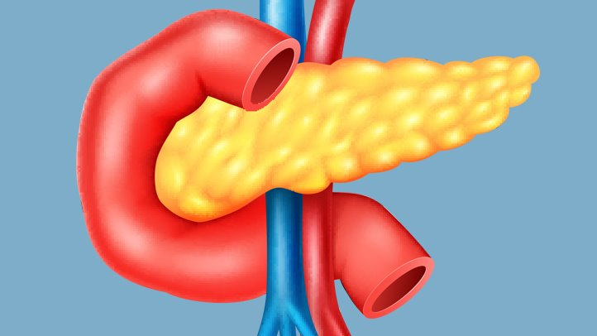
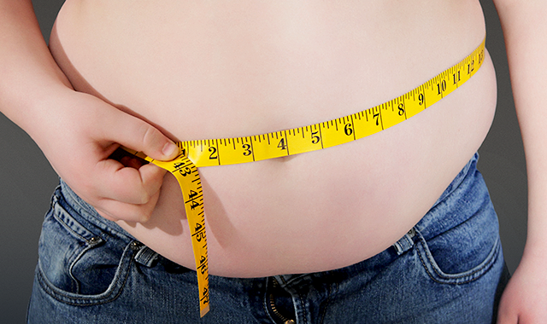
Air Pollution And
Diabetes
Long-term exposure to air pollution is associated with increased risk of diabetes.*
Air Pollution And
Obesity
Air Pollution is now recognised as a cause of Obesity.**
*Yang B-Y, Fan S, Thiering E, Seissler J, Nowak D, Dong G-H, et al. Ambient air pollution and diabetes: A systematic review and meta-analysis. Environmental Research. 2019;180:1-11.
Available from https://reader.elsevier.com/reader/sd/pii/S0013935119306140?token=435839E629DDD063803843DB7E7BE552DDBB2DD7CF828F0CCF45D3FE9CBF75BCE12F7201AD2E7B1EFEC760D7E7ED240A
**An R, Ji M, Yan H, Guan C. Impact of ambient air pollution on obesity: a systematic review. Int J Obes (Lond). 2018;42(6):1112–26.
Available from: https://www.nature.com/articles/s41366-018-0089-y

Slide 25
Air Pollution And Its Effects
Death
ER visits, Hospital admissions
Doctor visits, absence from work
Lung function decrements, Inflammation, Cardiac effects
Respiratory symptoms, medication use, Asthma attacks
Magnitude of impact
~ 7 Million
Severity of effects
Tens of Millions
Billions
Proportion of population affected

Slide 26
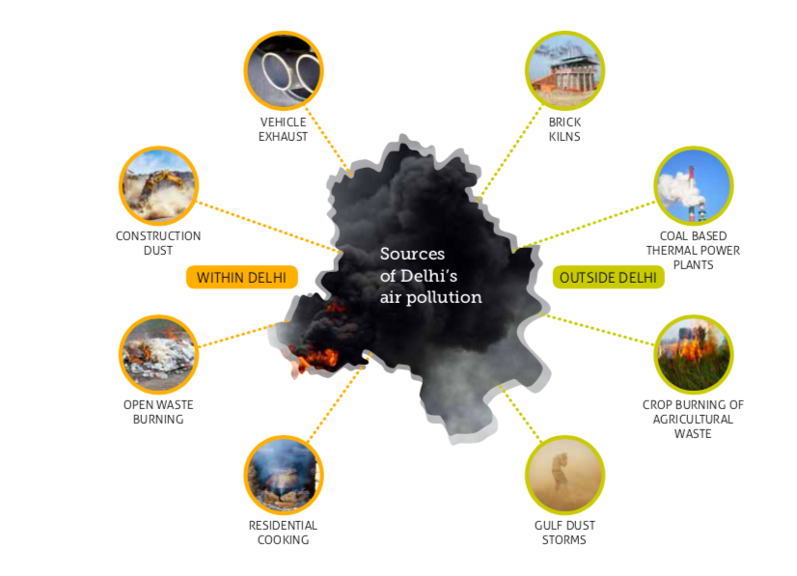
Common Causes of Pollution
Picture Source: Every Breath Counts report for Climate Trends, compiled by Bahar Dutt

Slide 27
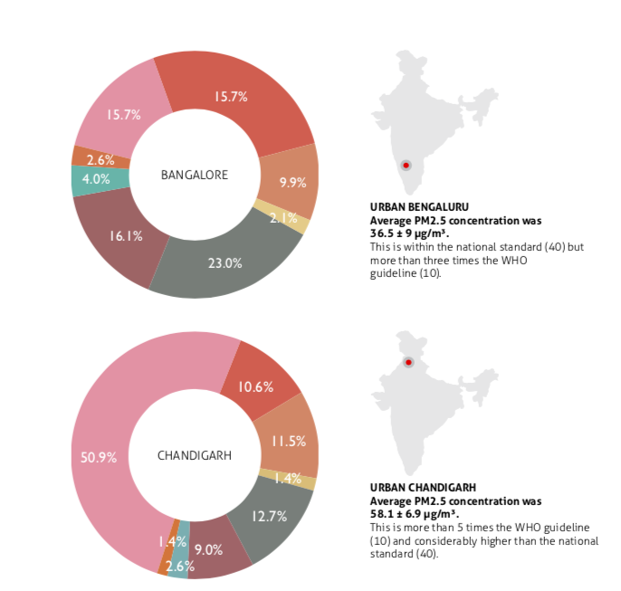
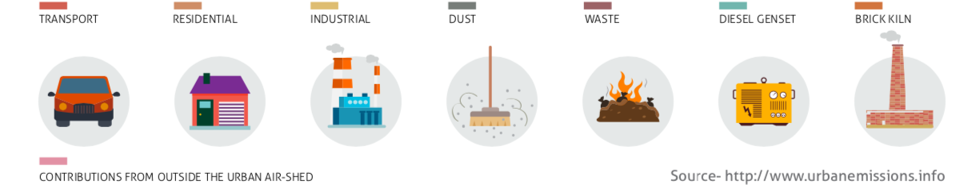
Common Causes of Pollution
Picture Source: Every Breath Counts report for Climate Trends, compiled by Bahar Dutt

Slide 28
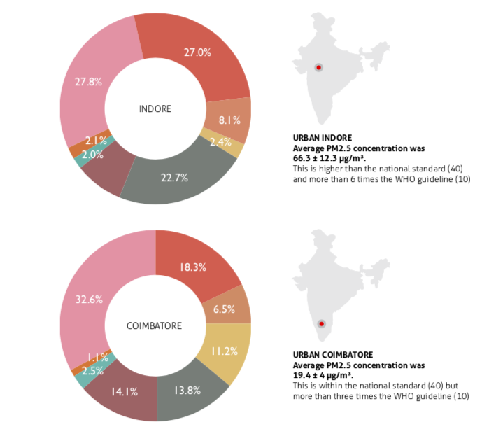
Common Causes of Pollution
Picture Source: Every Breath Counts report for Climate Trends, compiled by Bahar Dutt

Slide 29
What To Do When The Air Pollution Levels Are High?
Avoid any outdoor activities
Use N 95 Masks (simple Surgical / Cloth masks are not useful)
Drink plenty of water and stay hydrated
Consume more Vitamin C rich foods
In case of burning or irritation in the eyes, wash them with clean water
Keep children indoors
Keep the windows of your home closed
Schools should be shut
Avoid strenuous exercises and activities both outdoor and indoor

Slide 30
What do we do?
How do we reduce?
Lookout For
धु
धू
धुआं (Smoke)
धूल (Dust)
Smoke From:
Industry
Waste Burning
Cars
Crackers
Other sources
Dust From:
Roadside
Construction
Open Grounds
Uncovered Areas

Slide 31
What do we do?
How do we reduce?
In a nut-shell, reducing the use of anything that causes Smoke or Dust
Avoid purchase & use of plastic Bags/ single use plastic items
Waste segregation at the source
Covering up uncovered dust patches, ensuring dust free construction
Switching off vehicles at red lights > 15 Seconds
Reducing use of energy and vehicles
Shifting to cleaner fuel
Ensuring pollutions check of vehicle
Ensuring no burning of waste/ crackers
Responsible driving to reduce road congestion
Report instances of backyard/roadside burning of waste to the state pollution control boards
Spreading awareness
Each step taken is a Minute added to Your & Your Child’s Life

